Slide 1

Flocculator Extras

Slide 2
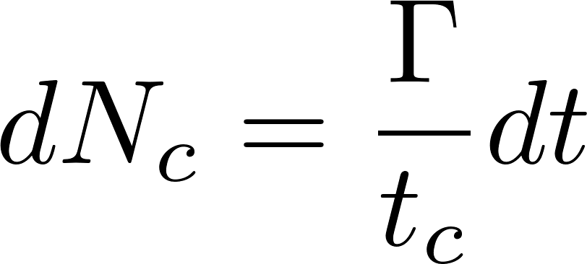
Surface coverage (Γ) of clay by coagulant precipitate
extra
In our modeling work we didn’t cover how to calculate what fraction of the clay surfaces are coated with coagulant. The following slides are the equation heavy derivation of that coverage. We assume coagulant precipitate has some characteristic diameter when it sticks to the clay and that the clay can be represented as a cylinder. We also assume that the coagulant sticks to everything including reactor walls. The coagulant approaches the clay surface randomly and thus accumulates in a Poisson distribution. The random bombardment means that some coagulant is wasted in double coverage of previously covered clay.
It is possible that the number of successful collisions is not simply directly proportional to surface coverage. It isn’t clear why surface coverage greater than about 50% would be of any benefit given that nanoparticles likely attach more strongly to clay than to nanoparticles.

Slide 3
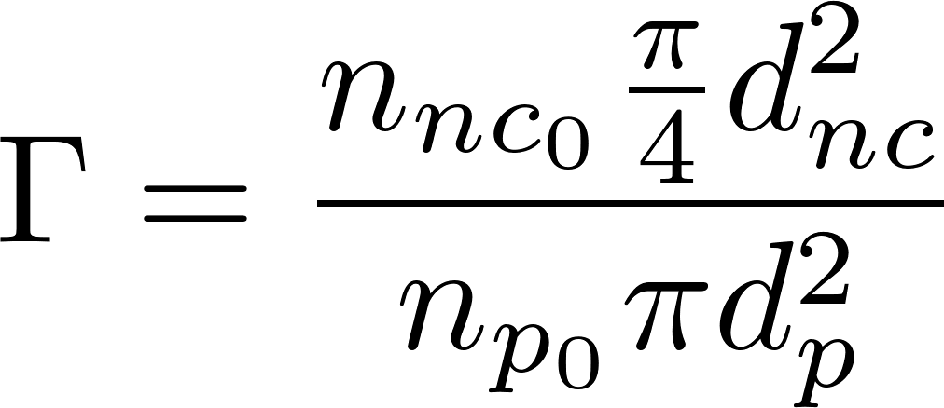
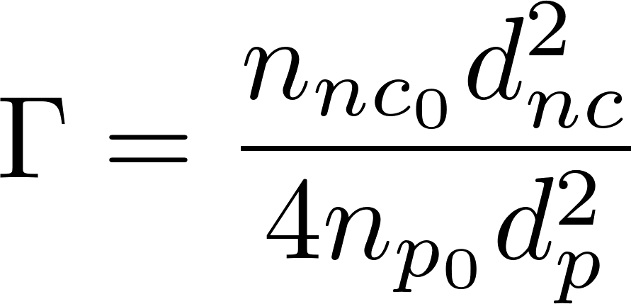
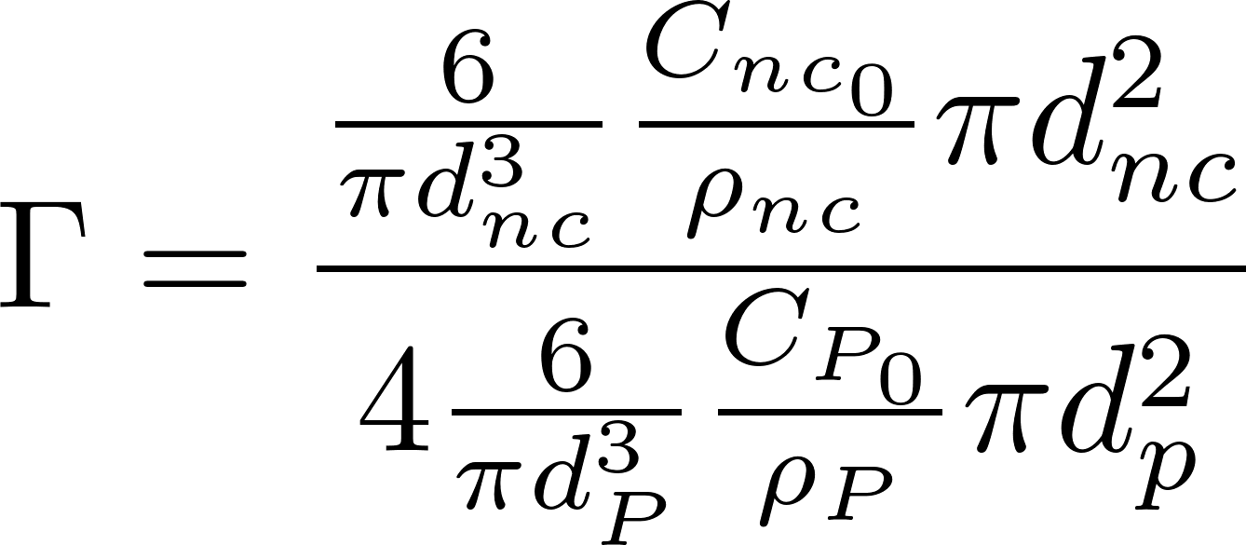
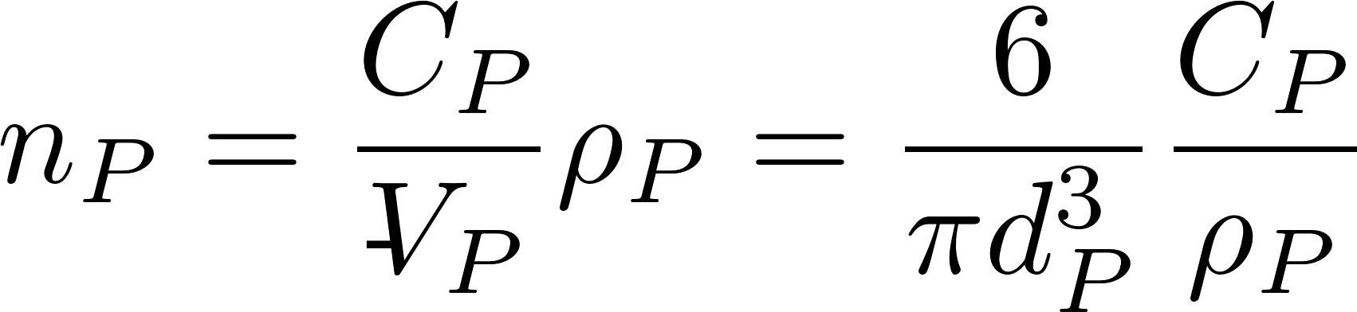
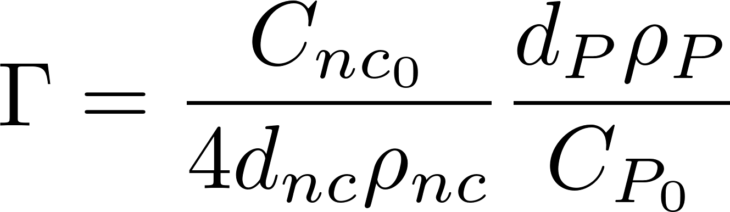
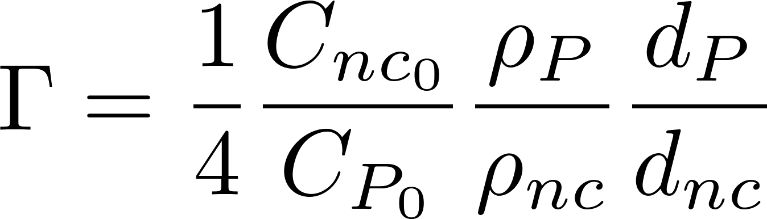
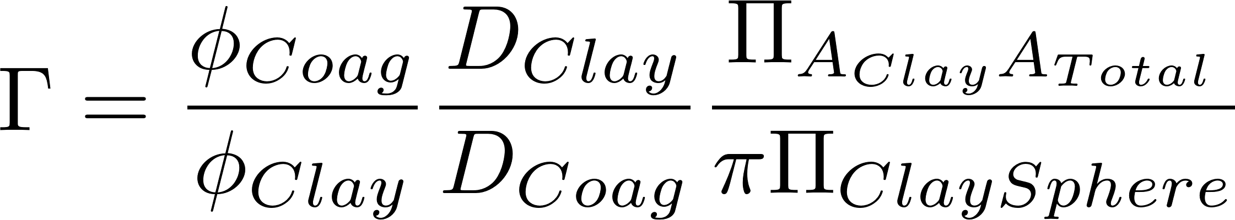
Surface coverage (Γ) << 1 and small loss to reactor walls
extra

Slide 4
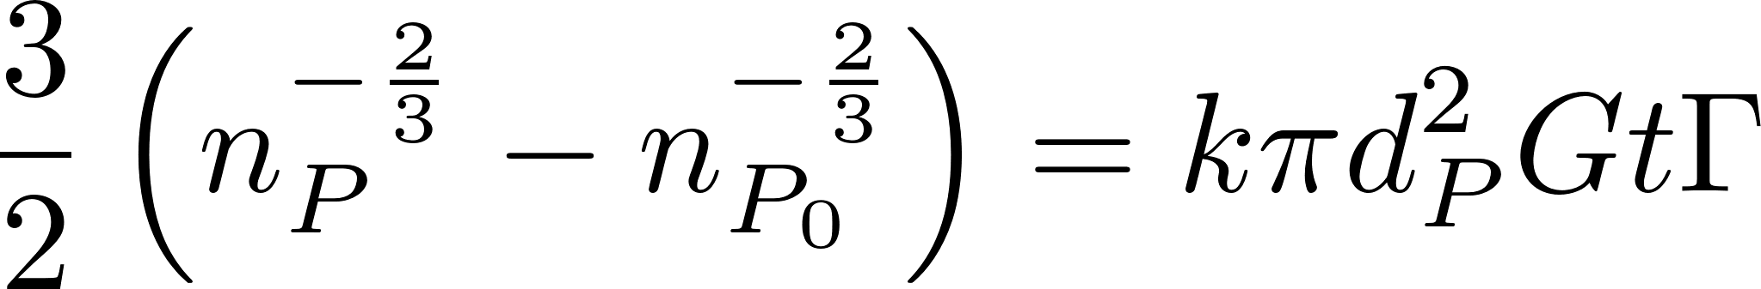
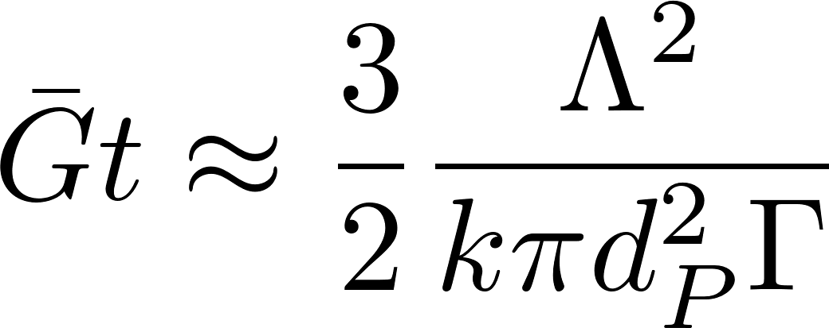
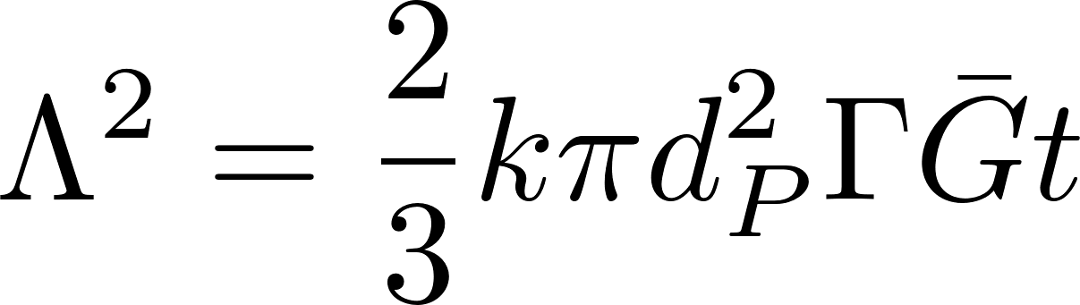
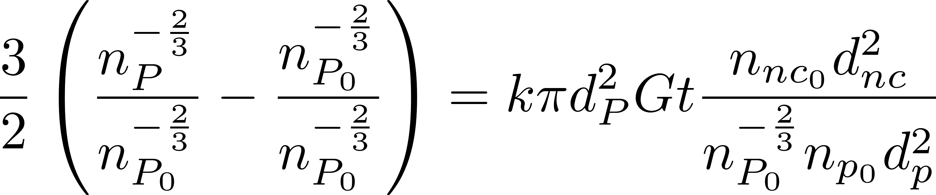
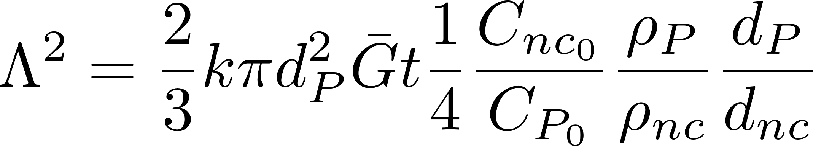
Surface coverage (Γ) << 1 and small loss to reactor walls
extra

Slide 5
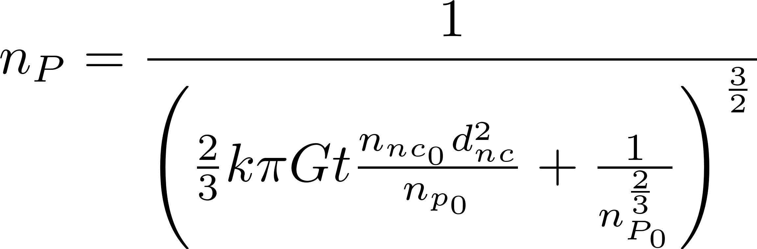
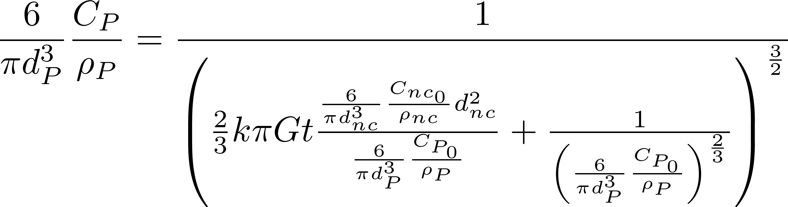
Even with simplified assumptions, including Γ complicates the analysis
extra

Slide 6
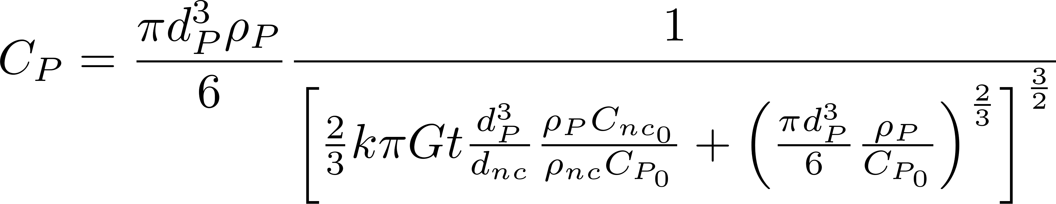
Solving for residual turbidity results in a complicated equation
extra

Slide 7
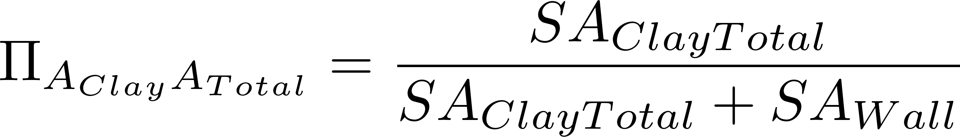
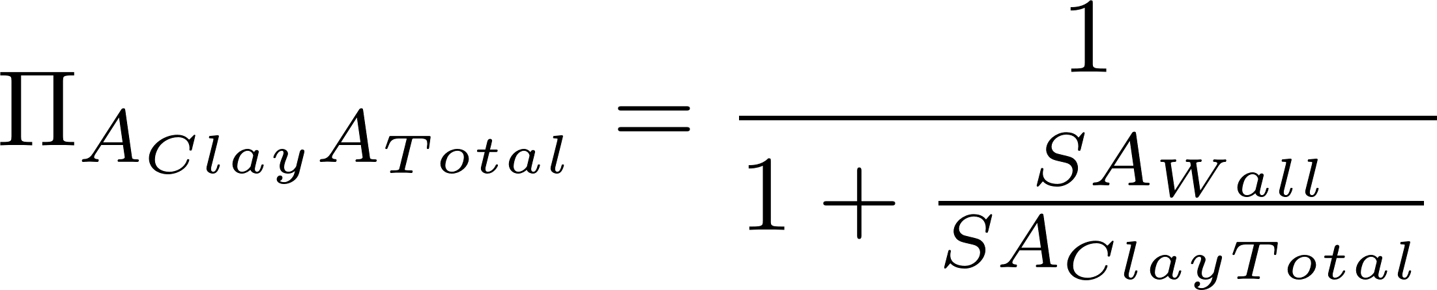
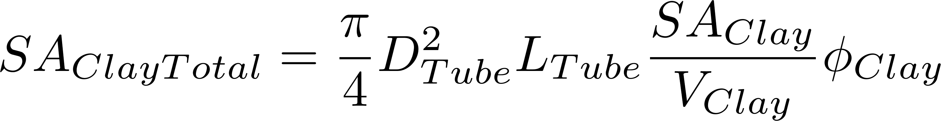
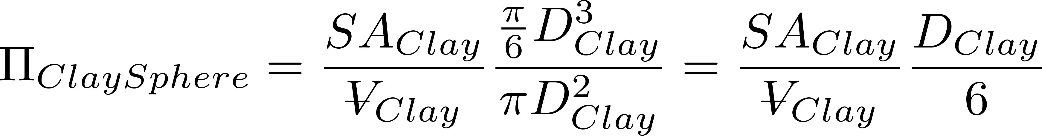
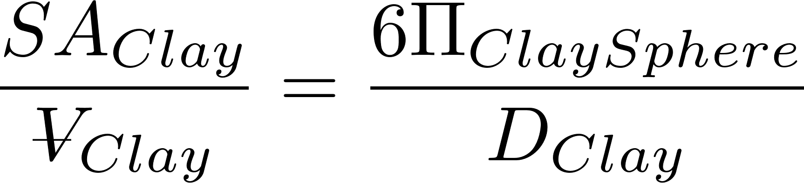
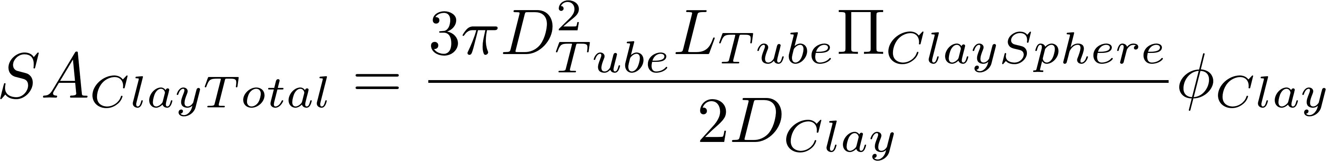
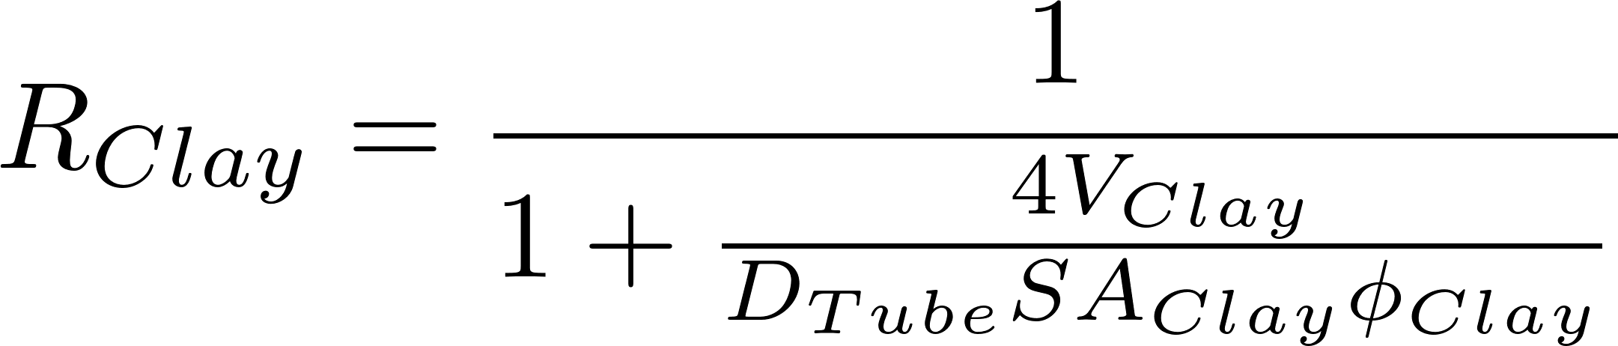
Floc Model Equations for Γ
extra
Surface area of clay divided by total surface area of clay + reactor walls
Surface area to volume ratio for clay normalized by surface area to volume ratio for a sphere

Slide 8
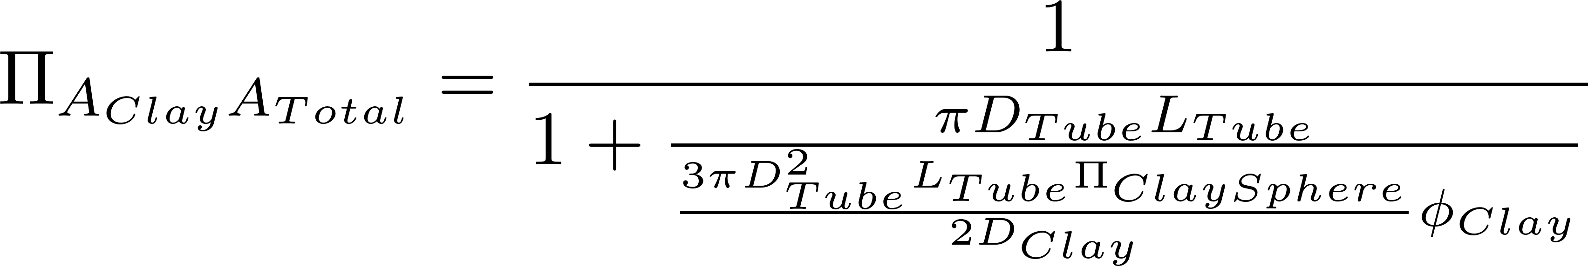
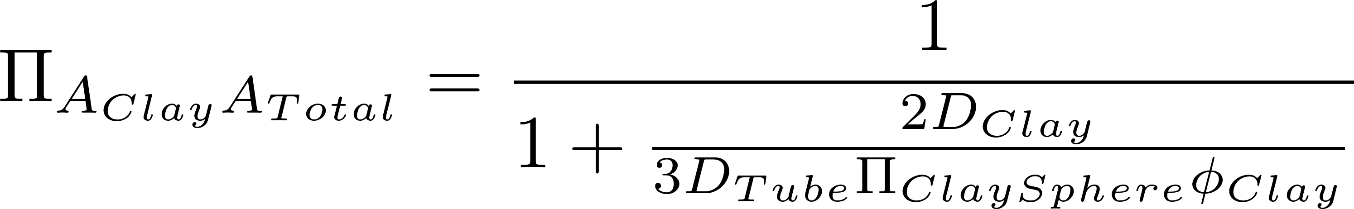
Ratio of clay surface area to total surface area (including reactor walls)
extra

Slide 9
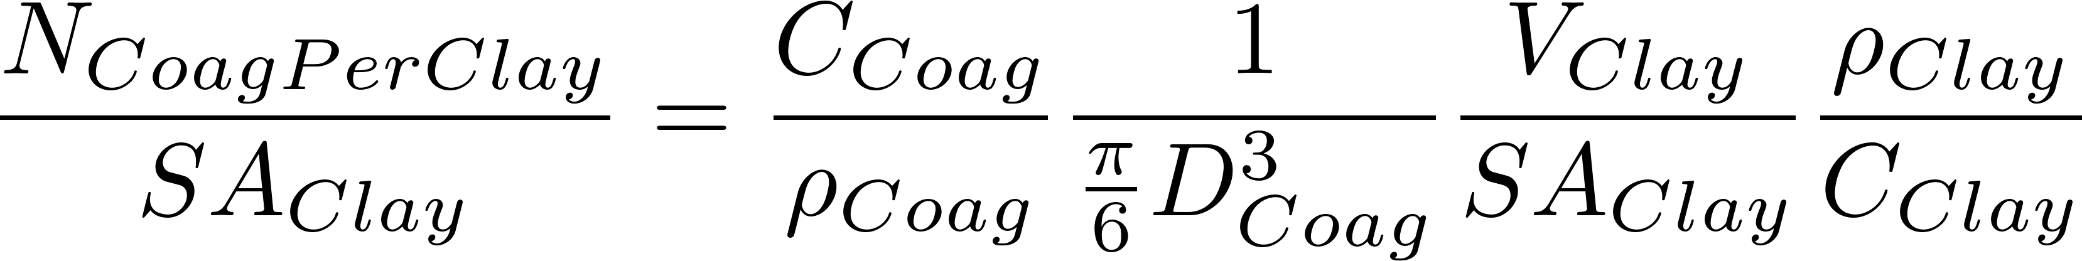
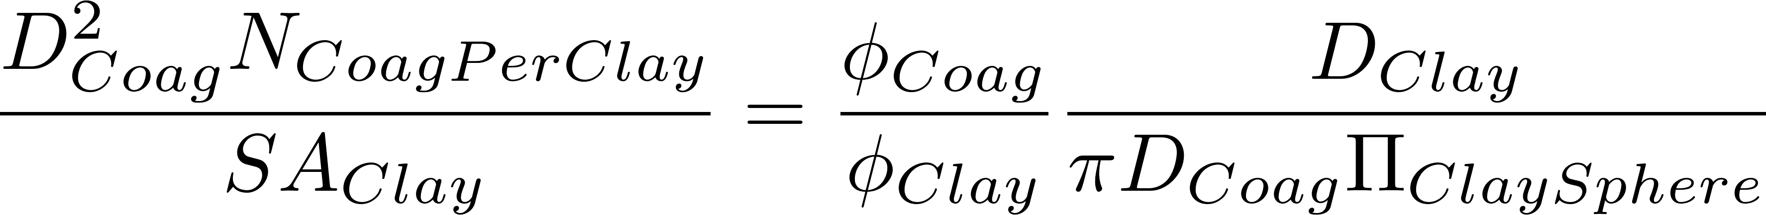
Poisson distribution and coagulant loss to walls combined to get surface coverage
extra

Slide 10
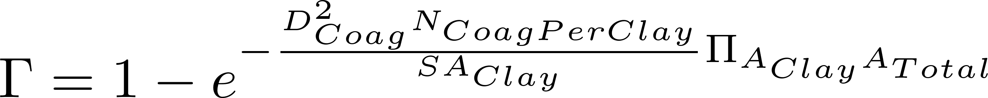
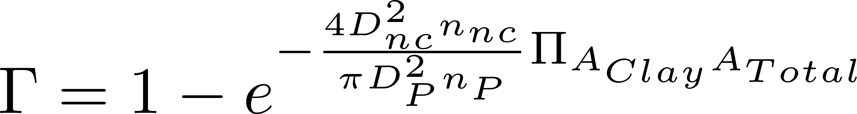
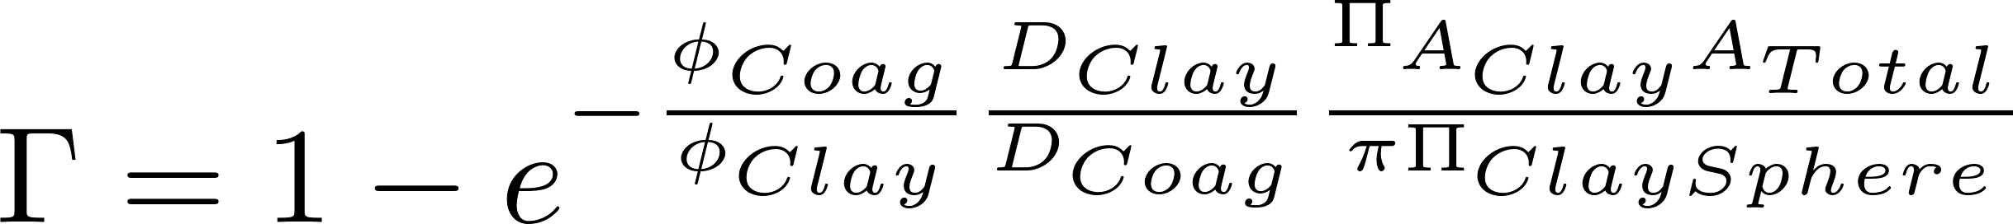
Poisson distribution and coagulant loss to walls combined to get surface coverage
extra
The surface coverage is reduced due to stacking (which is handled by the Poisson distribution) and by the loss of coagulant to the reactor walls.
loss of coagulant to the reactor walls

Slide 11
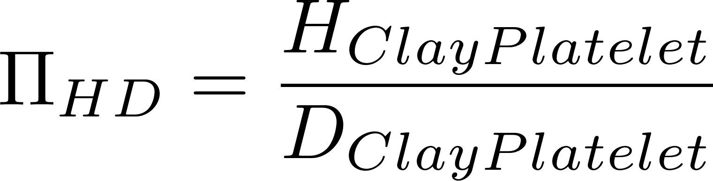
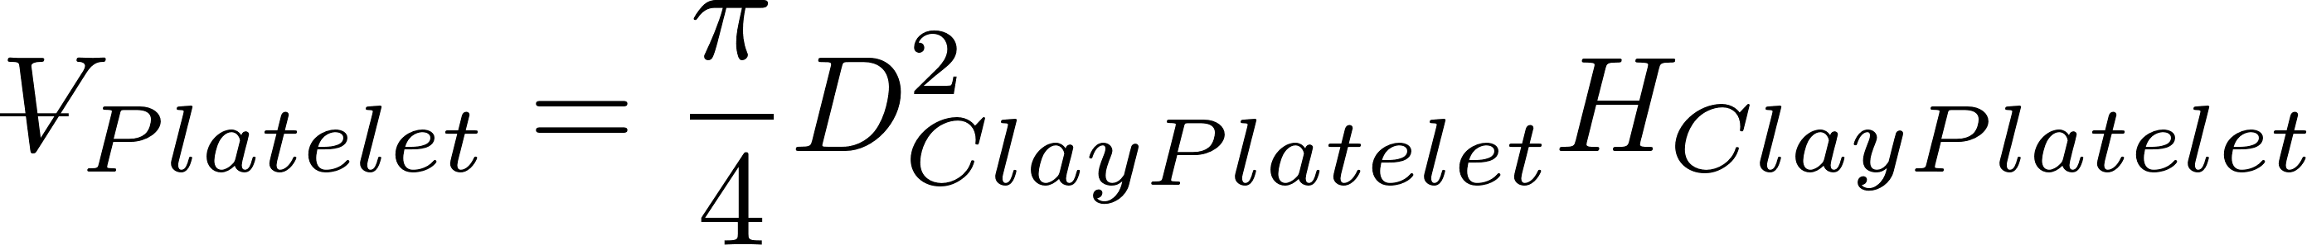
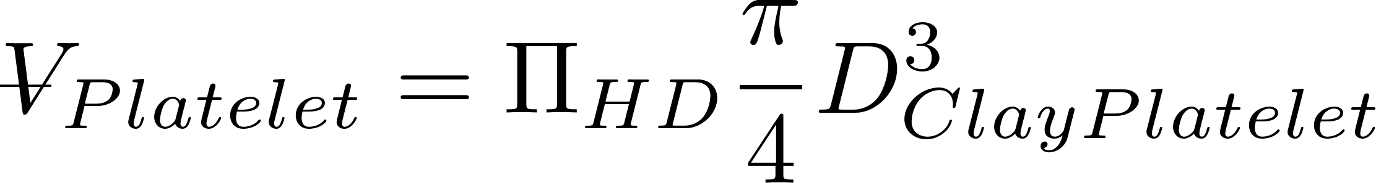
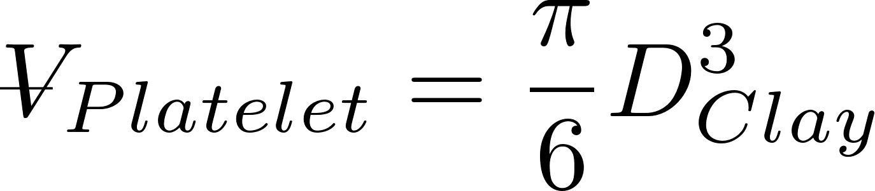
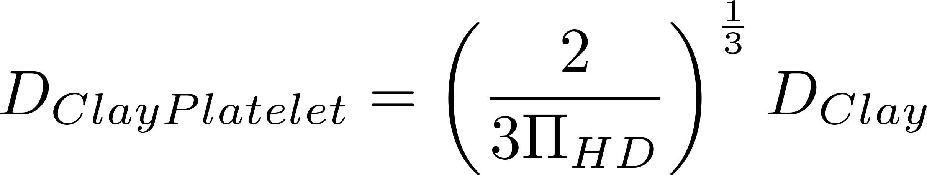
Clay platelet geometry
extra
Model clay as cylinder with height and diameter
D.Clay is the diameter of a sphere with equal volume as the clay platelet
D.ClayPlatelet is the diameter of a cylinder given ratio of height to diameter and equal volume spherical diameter

Slide 12
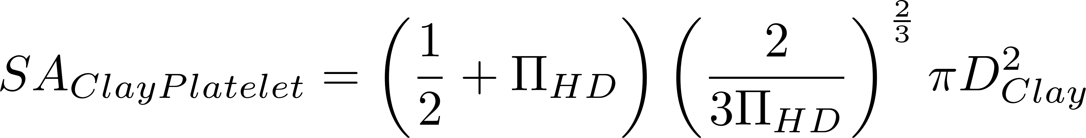
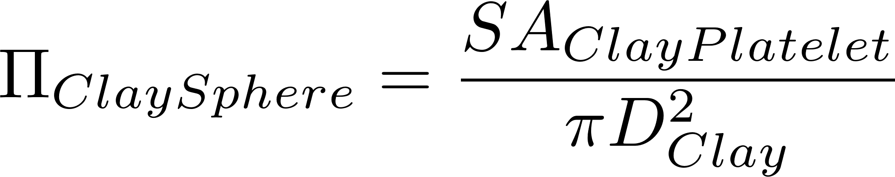
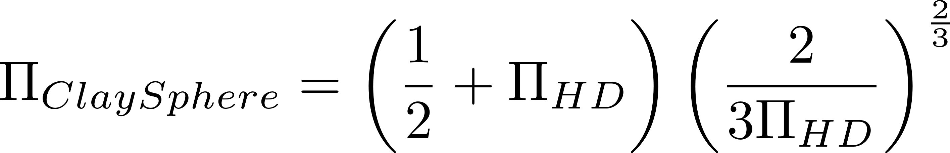
Clay platelet geometry
extra

Slide 13
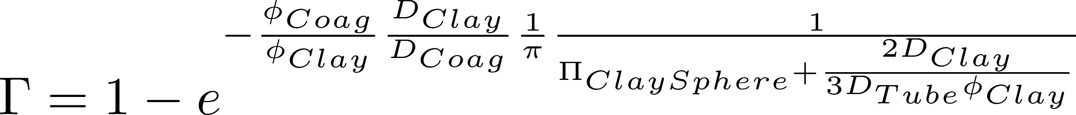
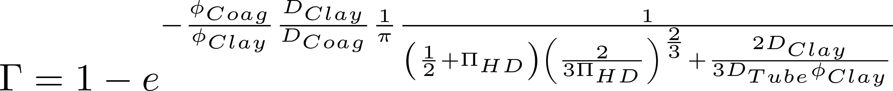
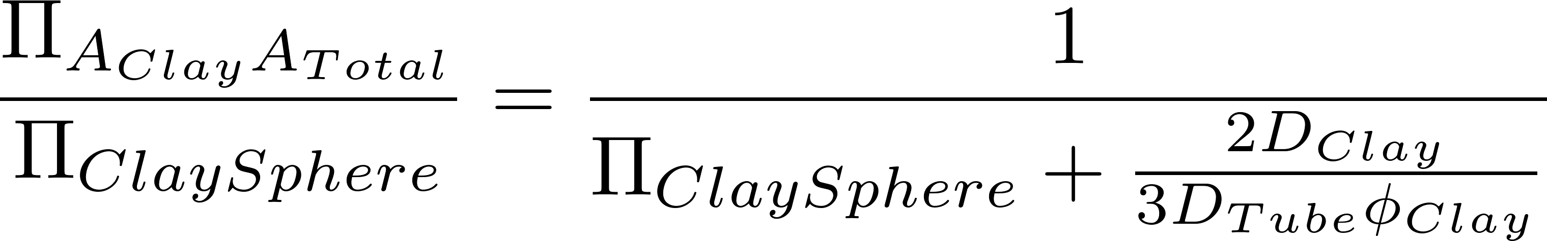
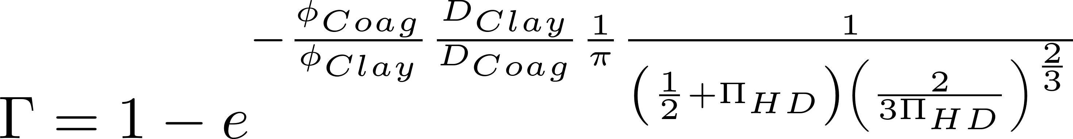
Surface coverage of clay
extra
If you neglect wall loses

Slide 14
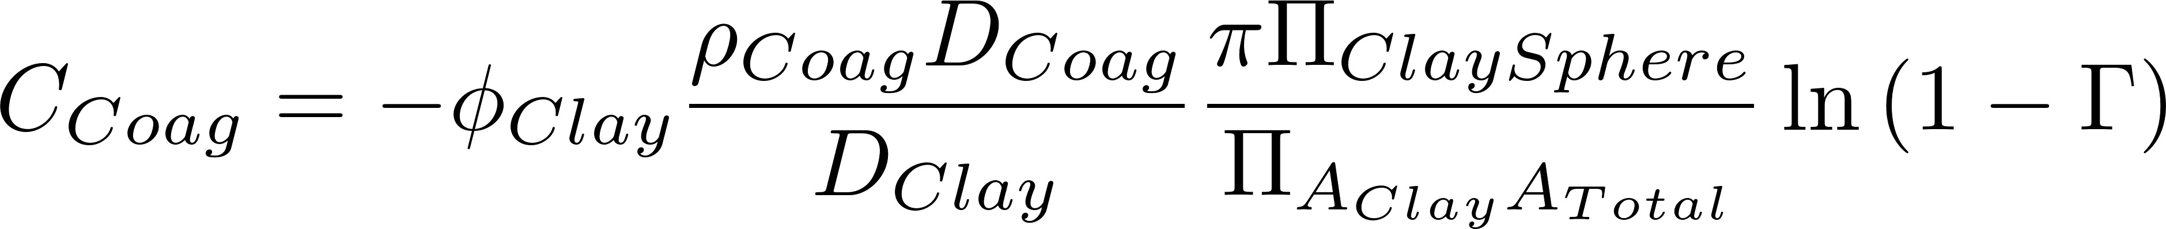
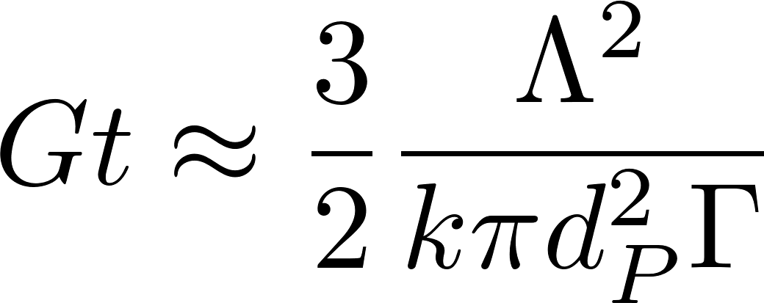
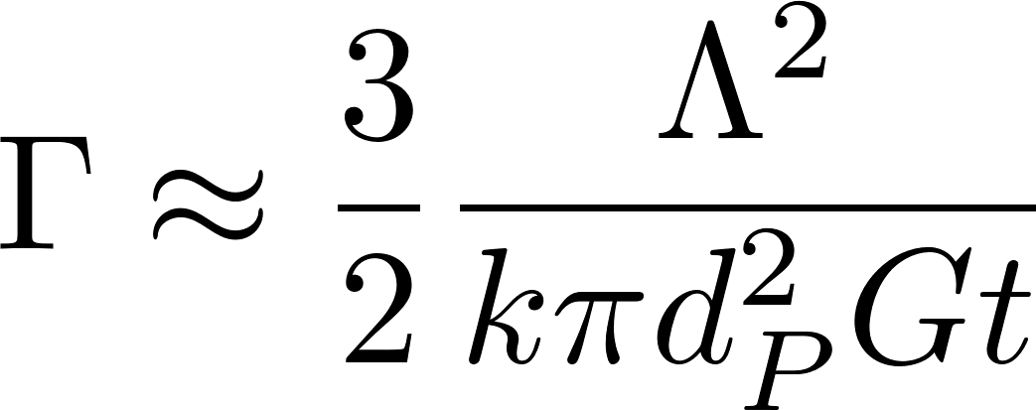
Solving for Coagulant Dose
extra
Coagulant dose is inside coagulant volume fraction
Solve for dose…
Given a target residual turbidity, solve for required Γ, then solve for coagulant dose

Slide 15
Loss of clay to reactor walls
extra
Loss of coagulant to reactor walls can dominate for low turbidities and small reactors. For the EStaRS in India treating 5 NTU water and injecting coagulant into 7.5 cm pipes the clay only gets 23% of the applied coagulant!
There may be a way to design a larger contact chamber for the coagulant to reduce losses to the walls.
Notes:
FractalFlocModel.xmcd (Mathcad 15 files)

Slide 16
Effect of stacking and wall loss in a 10 cm diameter flocculator with 20 NTU
extra
Stacking due to random bombardment of the clay surface with coagulant nanoparticles. Stacking becomes significant for high surface coverage. Wall losses also cause a significant reduction in clay surface coverage.

Slide 17
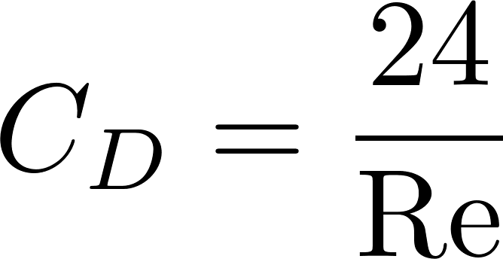
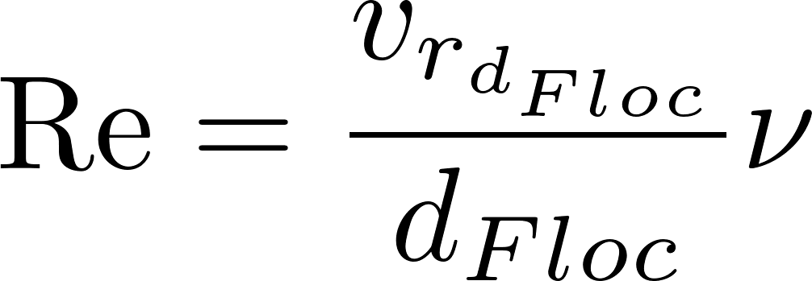
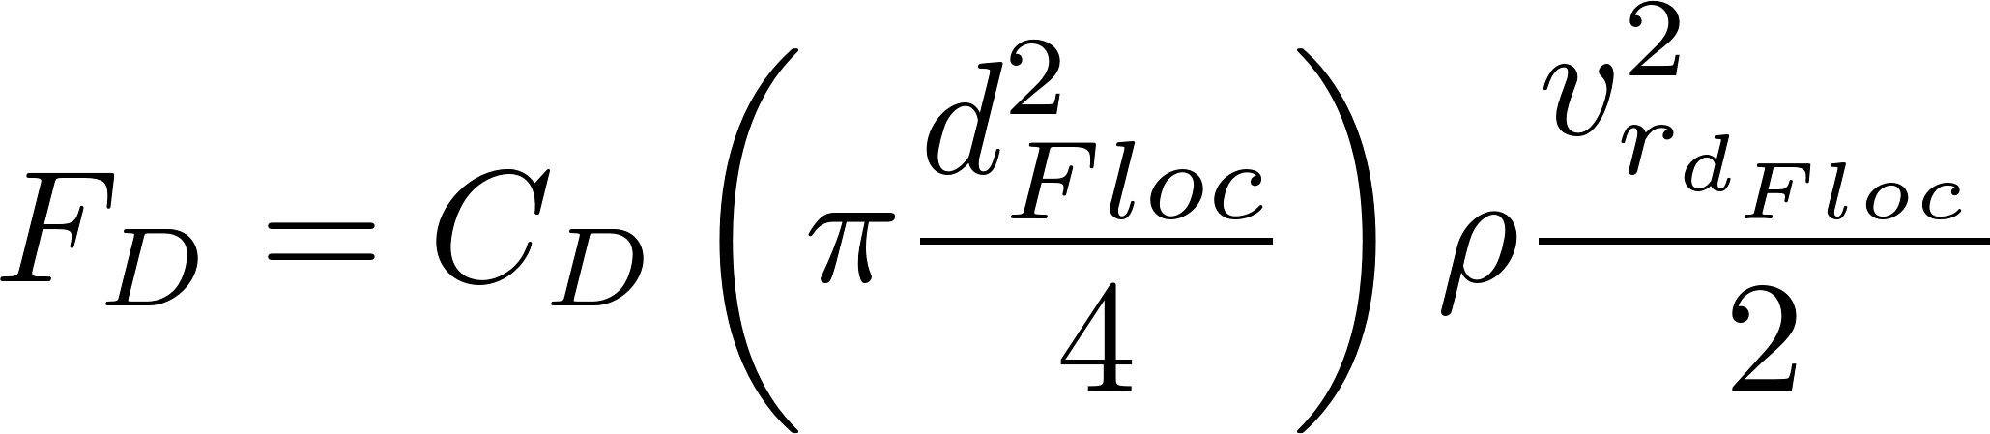
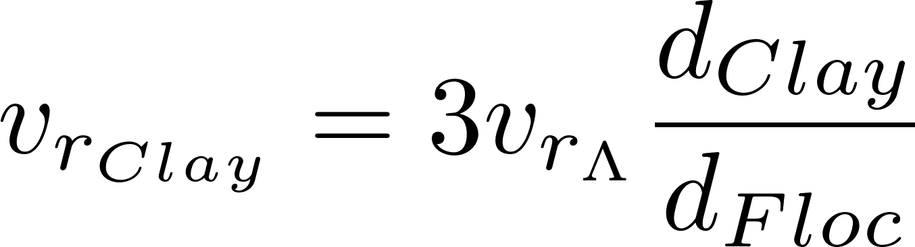
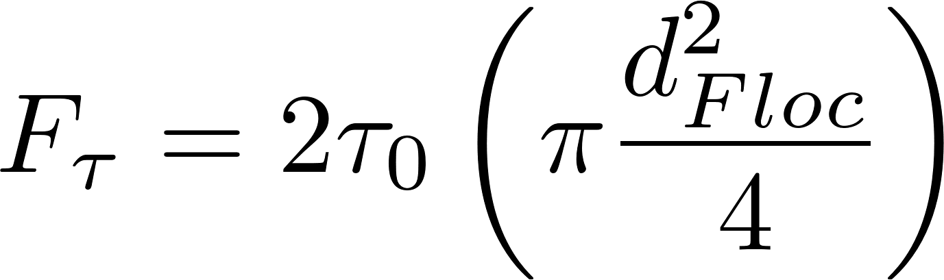




Slow velocity through the annulus, Fast velocity at separation Λ
Find the average shear on the floc surface based on the drag at low Re
The
Shear at the floc surface related to velocity gradient at the floc surface
The velocity gradient is steeper at the surface of the floc than it is further from the floc.

Slide 18





CMFR model

Slide 19





Small particle diameter cancels out!
Flocculator must increase in volume by factor of 4.6 to reduce turbidity by factor of 10

Slide 20






Slide 21






Comparison with Karen’s model
Karen’s empirical model
Floc model
neglecting initial conditions
Use phi notation
Prepare to convert to initial phi
The equations are NOT the same

Slide 22
Why might floc collision fail if the flocs are of very different sizes?
Tangent and rotational velocities cause shear and unzipping of bonds between particles of different sizes
Tangent velocity is proportional to the sum of the diameters of the particles
Flocs reach a terminal size based on a balance of the adhesive force of the bonds and the shear force that tends to tear them apart
Once a floc has reached its terminal size any further collisions are unsuccessful
Very few small particles get close enough to a big floc to collide

Slide 23

Collision of two small flocs
Tangent velocities of the particles surfaces at collision is similar in magnitude to the normal velocity

Slide 24

Collision of a small floc with a large floc
Tangent velocities of the approaching particle surfaces increase as size of either particle increases
Bonds formed on impact are unzipped due to rotation and high tangent velocities (perhaps a maximum relative velocity?)

Slide 25





Collision of a small floc with a large floc
Translational velocity of small particle, $V_{t_{2}}$
Rotational velocity of top of large particle, $V_{r_{1}}$
Rotational velocity of bottom of small particle,$V_{r_{2}}$
2
1
Velocity gradient, G

Slide 27



How do we quantify the turbulence level?
extra
The energy dissipation rate, ε, is a measure of the turbulence
It is in the regions of maximum ε where the flocs are most likely to break
mW/kg

Slide 28


Extracting ε from Velocity Gradient Design Guideline?
extra
The value of the velocity gradient that was used previously for flocculator design had a range of 20 – 200 s⁻¹
The equivalent range for ε is 0.4 – 40 mW/kg
Kinematic viscosity
Velocity gradient
Notes:
This is the first of 3 methods to obtain estimates for the energy dissipation rate (traditional G values, traditional velocity values, floc size in a shear environment.

Slide 29

Extracting ε_{Max} from Fluid Velocity Design Guidelines?
extra
Traditional guidelines for velocity are between 0.1 and 0.3 m/s.
Equivalent to of 0.5 to 15 mW/kg

Slide 30


Design Considerations
Design is dominated by material size and constructability
Channels must be wide enough to be constructible (45 cm)
The material used for flexible plastic baffles is expensive and waste should be minimized

Slide 31


Vertical vs. Horizontal Flow
extra
For small plants…
Horizontal flow flocculators are shallow and thus need to be elevated so the water level in the flocculator matches the sedimentation tank
Vertical flow flocculators take up less space (smaller footprint) because they are deeper
For large plants…
Horizontal flow can be made as deep as the sedimentation tank and are preferred because they are easier to drain
Notes:
Note that these recommendations are the opposite of the recommendations from CEPIS! CEPIS used deep horizontal flow flocculators even for relatively low flow rates (less than 50 L/s). The result is many flocculators with extremely close baffle spacing and resulting inefficient use of flocculator volume because of high variability in energy dissipation rate.

Slide 32
Vertical vs. Horizontal Revisited
extra
Vertical flow flocculators are somewhat difficult to drain and clean
For large flows, vertical flow flocculators have channels that are wider than they are deep
Why not switch to horizontal flow flocculators for large flows?
Why not use horizontal flow for all flows?

Slide 33

Horizontal flow for all flows?
extra
5 Lps plant with horizontal flocculator
This is a bad alternative because concrete slab floor, roof, walls, and land are all expensive!!!

Slide 34


Horizontal Flow Flocculator
extra
Depth of the water is known (W)
Width of the channel is H (unknown)
Use H/S of 3 as a constraint
Solve for S and then finally solve for H
Eliminate H with H/S

Slide 35


Minimum Flow rate for Horizontal Flocculators given H?
extra
The construction constraint requires that baffles be at least 45 cm (we will use 60 cm) apart (S).
The depth of water is W
Use an H/S of 3 and calculate H
Solve for Q

Slide 36

Minimum Flow rate for Horizontal Flocculators?
extra
The minimum flow rate for a 2 m deep tank is about 250 L/s
If we build shallower flocculators then we could design horizontal flocculators for lower flow rates (perhaps as low as 50 L/s), but this would increase plant size
Water surface elevations (sed and floc) must match!
So… don’t expect to see any AguaClara horizontal flocculators

Slide 37


And More Details
extra
How will we fill or drain the flocculator?
What force must the baffles be able to withstand?
Polycarbonate baffles
Ferrocement baffles

Slide 38
Small Drain Ports at the bottom of the lower baffles?
extra
The ports would have a smaller size than the space between baffles
The energy dissipation rate in the jet that flows through the ports will be higher than the energy dissipation rate produced by the baffles
Preliminary evidence from the AguaClara plant at Marcala, Honduras suggests that this approach works well and can still produce low residual turbidity

Slide 39

Hydrostatic Force: Vertical flow flocculator
extra
Upper baffles
S
H
B
S
S
L
Lower baffles
W currently use 1.5S above and below the baffles
Notes:
Change this image to have 1.5 S

Slide 40

Hydrostatic Force
extra
Where will the baffle break?
If we make the baffle from 4 plates, what force will the lowest plate have to withstand?

Slide 41






Hydrostatic Force
extra

Slide 42



Hydrostatic Force
extra
3413
N

Slide 43
Pro Uniform Flocculation
extra
Most energy efficient (less head loss) or
Given same amount of energy, lower residence time!
Unlikely that the higher shear levels would result in significant changes in floc density or strength
Easier to build
Until we have solid evidence that tapered is better we will use a constant ε

Slide 44





Smallest Turbulent Flow Flocculator (analysis for lab flocculator)
extra
Substitute W=S and eliminate H. Then solve for Q
This is a fundamental equation showing energy dissipation is proportional to velocity cubed

Slide 45




Add Reynolds constraint
extra
Solve for S to get minimum S given Reynolds constraint

Slide 46

Minimum Turbulent Flow Flocculation
extra
Combine equation for Q and S to get Q as function of Re.
The minimum flow for a turbulent flow reactor is about 110 mL/s. The minimum S is 3.66 cm

Slide 47











Get equation for Spacing as function of head loss

Slide 48



Find αε as function of head loss

Slide 49







Find residence time as function of Head Loss

Slide 50



Plan View Area as a function of head loss

Slide 51




Cost of floc baffles and walls due to head loss
I assume optimal design has S=W
Floc tank walls
baffles

Slide 52



Cost as function of head loss

Slide 53
Optimal head loss for a flocculator given 70 m^2/3 collision potential
Notes:
See file Optimal Energy Dissipation rate minimum reactor volume
Of course, this is a function of our cost estimates.

Slide 54
Optimal average and maximum energy dissipation rates
This suggests increasing the maximum energy dissipation rate to about 50 mW/kg, but if we can improve H/S, then we will want to use a lower energy dissipation rate.
Notes:
This analysis was done before making the H/S ratio optimal for all designs.

Slide 55
Optimal velocity gradient
The velocity gradient based on the average energy dissipation rate is in the conventional range of 20 to 180/s

Slide 56




Head loss

Slide 57




What is the cost ratio?
Express cost as a wall or ceiling or slab area.
Then cost per plan view area can be approximated as area per plan view area. This assumes that roof, slab, plant walls, and tank walls all have the same cost per unit area.
Cost per plan view area is due to slab and roof and tank walls. Slab and roof are order 2 if expressed as area of slab and roof per area of flocculator.
Tank wall area is H.Floc/W.Floc
Cost per head loss is due to elevation of entrance tank and taller exterior walls of plant
Walls are 4*square root of plant area

Slide 58





Can I find Q where H/S is at transition?
Use optimal head loss for Small H/S

Slide 59
As flow increases
H/S>5 and narrow W.Floc
H/S=5 as W.Floc increases to

Slide 60





Starting from Max EDR
BOD of max EDR
Calculate residence time, head loss and reactor volume
Select channel width based on reactor volume, depth, length, and odd or even number of channels

Slide 61




Starting from Average EDR
BOD of max EDR
Calculate residence time, head loss and reactor volume
Select channel width based on reactor volume, depth, length, and odd or even number of channels
Set and solve for W
Need an algorithm to solve for

Slide 62

Find maximum H given minimum W

Slide 63


Find min Q that doesn’t require obstacles
Use min W and max H/S of 5 to get minimum Q below which obstacles are needed

Slide 64
Find Max Q for vertical flow flocculator
Use max W and min H/S of 3 to get maximum Q for vertical flow flocculator

